Slide 1

Dynamic Routing Protocol (RIP)
Dr. Risala T Khan
Professor
IIT, JU

Slide 2
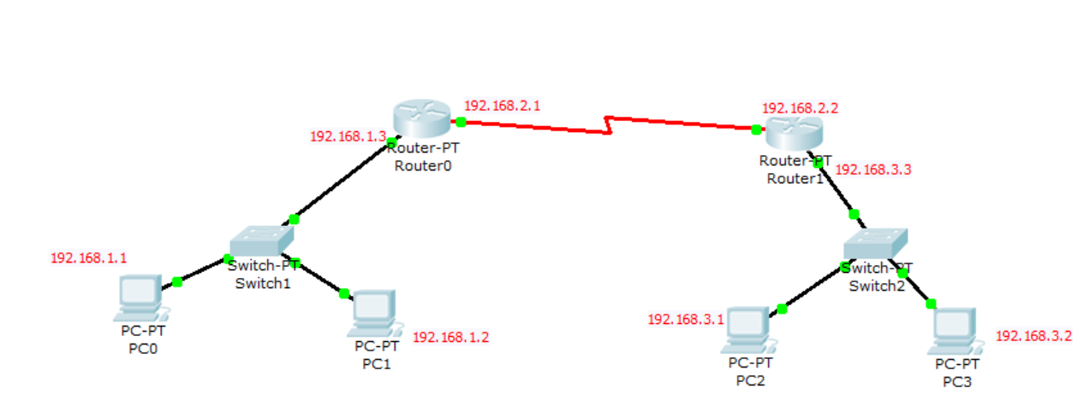
Design a network using following ip addresses

Slide 3
Do the following tasks
Enable each interface of each router
Provide default gateway address to each PC
Provide clock rate to appropriate interface
DO NOT ENABLE STATIC ROUTING

Slide 4
Configuring RIPv2
Configuring RIPv2 is a pretty straightforward process.
Only three steps are required:
1. enabling RIP by using the router rip global configuration command 2. instructing the router to use RIPv2 by typing the version 2 command 3. telling RIP which networks to advertise by using one or more network commands.
With the network command you specify which interfaces will participate in the routing process.
This command takes a classful network as a parameter and enables RIP on the corresponding interfaces.

Slide 5
For the Case of Router1
Router>enable
Router#conf t
Router(config)#router rip
Router(config-router)#version 2
Router(config-router)#network 192.168.2.0
Router(config-router)#network 192.168.3.0
Router(config-router)#

Slide 6
For the case of Router0
Router>enable
Router#conf t
Router(config)#router rip
Router(config-router)#version 2
Router(config-router)#network 192.168.1.0
Router(config-router)#network 192.168.2.0
Router(config-router)#

Slide 7
To Check
You can verify that router R0 have a route to the R1’s directly connected subnet by typing the show ip route command as follows:
Router>enable
Router#show ip route
Codes: C - connected, S - static, I - IGRP, R - RIP, M - mobile, B - BGP
D - EIGRP, EX - EIGRP external, O - OSPF, IA - OSPF inter area
N1 - OSPF NSSA external type 1, N2 - OSPF NSSA external type 2
E1 - OSPF external type 1, E2 - OSPF external type 2, E - EGP
i - IS-IS, L1 - IS-IS level-1, L2 - IS-IS level-2, ia - IS-IS inter area
* - candidate default, U - per-user static route, o - ODR
P - periodic downloaded static route
Gateway of last resort is not set
C 192.168.1.0/24 is directly connected, FastEthernet0/0
C 192.168.2.0/24 is directly connected, Serial2/0
R 192.168.3.0/24 [120/1] via 192.168.2.2, 00:00:24, Serial2/0
Router#

Slide 8
CLASSWORK
USE RIP ALONG WITH STATIC ROUTING AND SEE THE CHANGE IN “SHOW IP ROUTE” COMMAND

